Slide 1
MedOpp Advising Management System
Tony Vazquez, Zandria Johnson, Camille Frazier, Taylor McNeal

Slide 2

Our Client
The MedOpp Advising Office provides pre-professional advising for ALL pre-med (allopathic, osteopathic, and podiatry) pre-dental, pre-optometry, and pre-physician assistant students at the University of Missouri.
On average, students who take advantage of this free service are accepted into medical professional schools at levels far above the national acceptance rate.

Slide 3
Our Project
The MedOpp office supports around 100 students each academic year.
This support takes the form of seminars, workshops, Committee Interviews, letters of evaluation handling and more.
Our database tracks student progress through the program, providing feedback on success rates, workshop participation, correspondence tracking and more.
Primary goal was to provide a clean interface for saving student participation data, without poring through several excel files and paper forms.

Slide 4
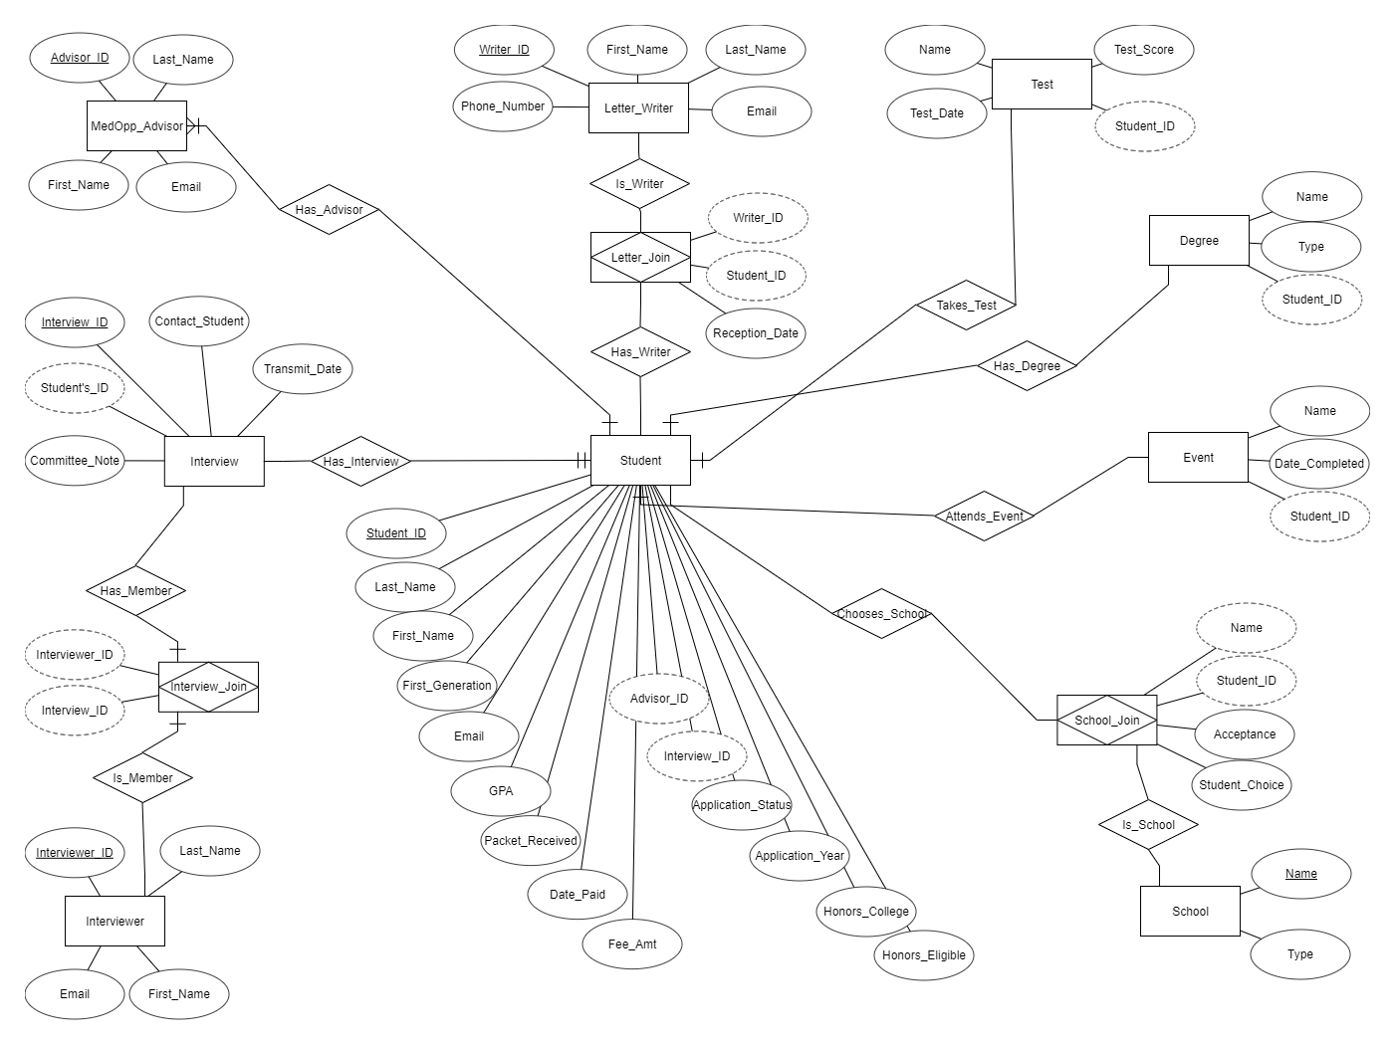
Preliminary ERD
Important lesson learned here!

Slide 5
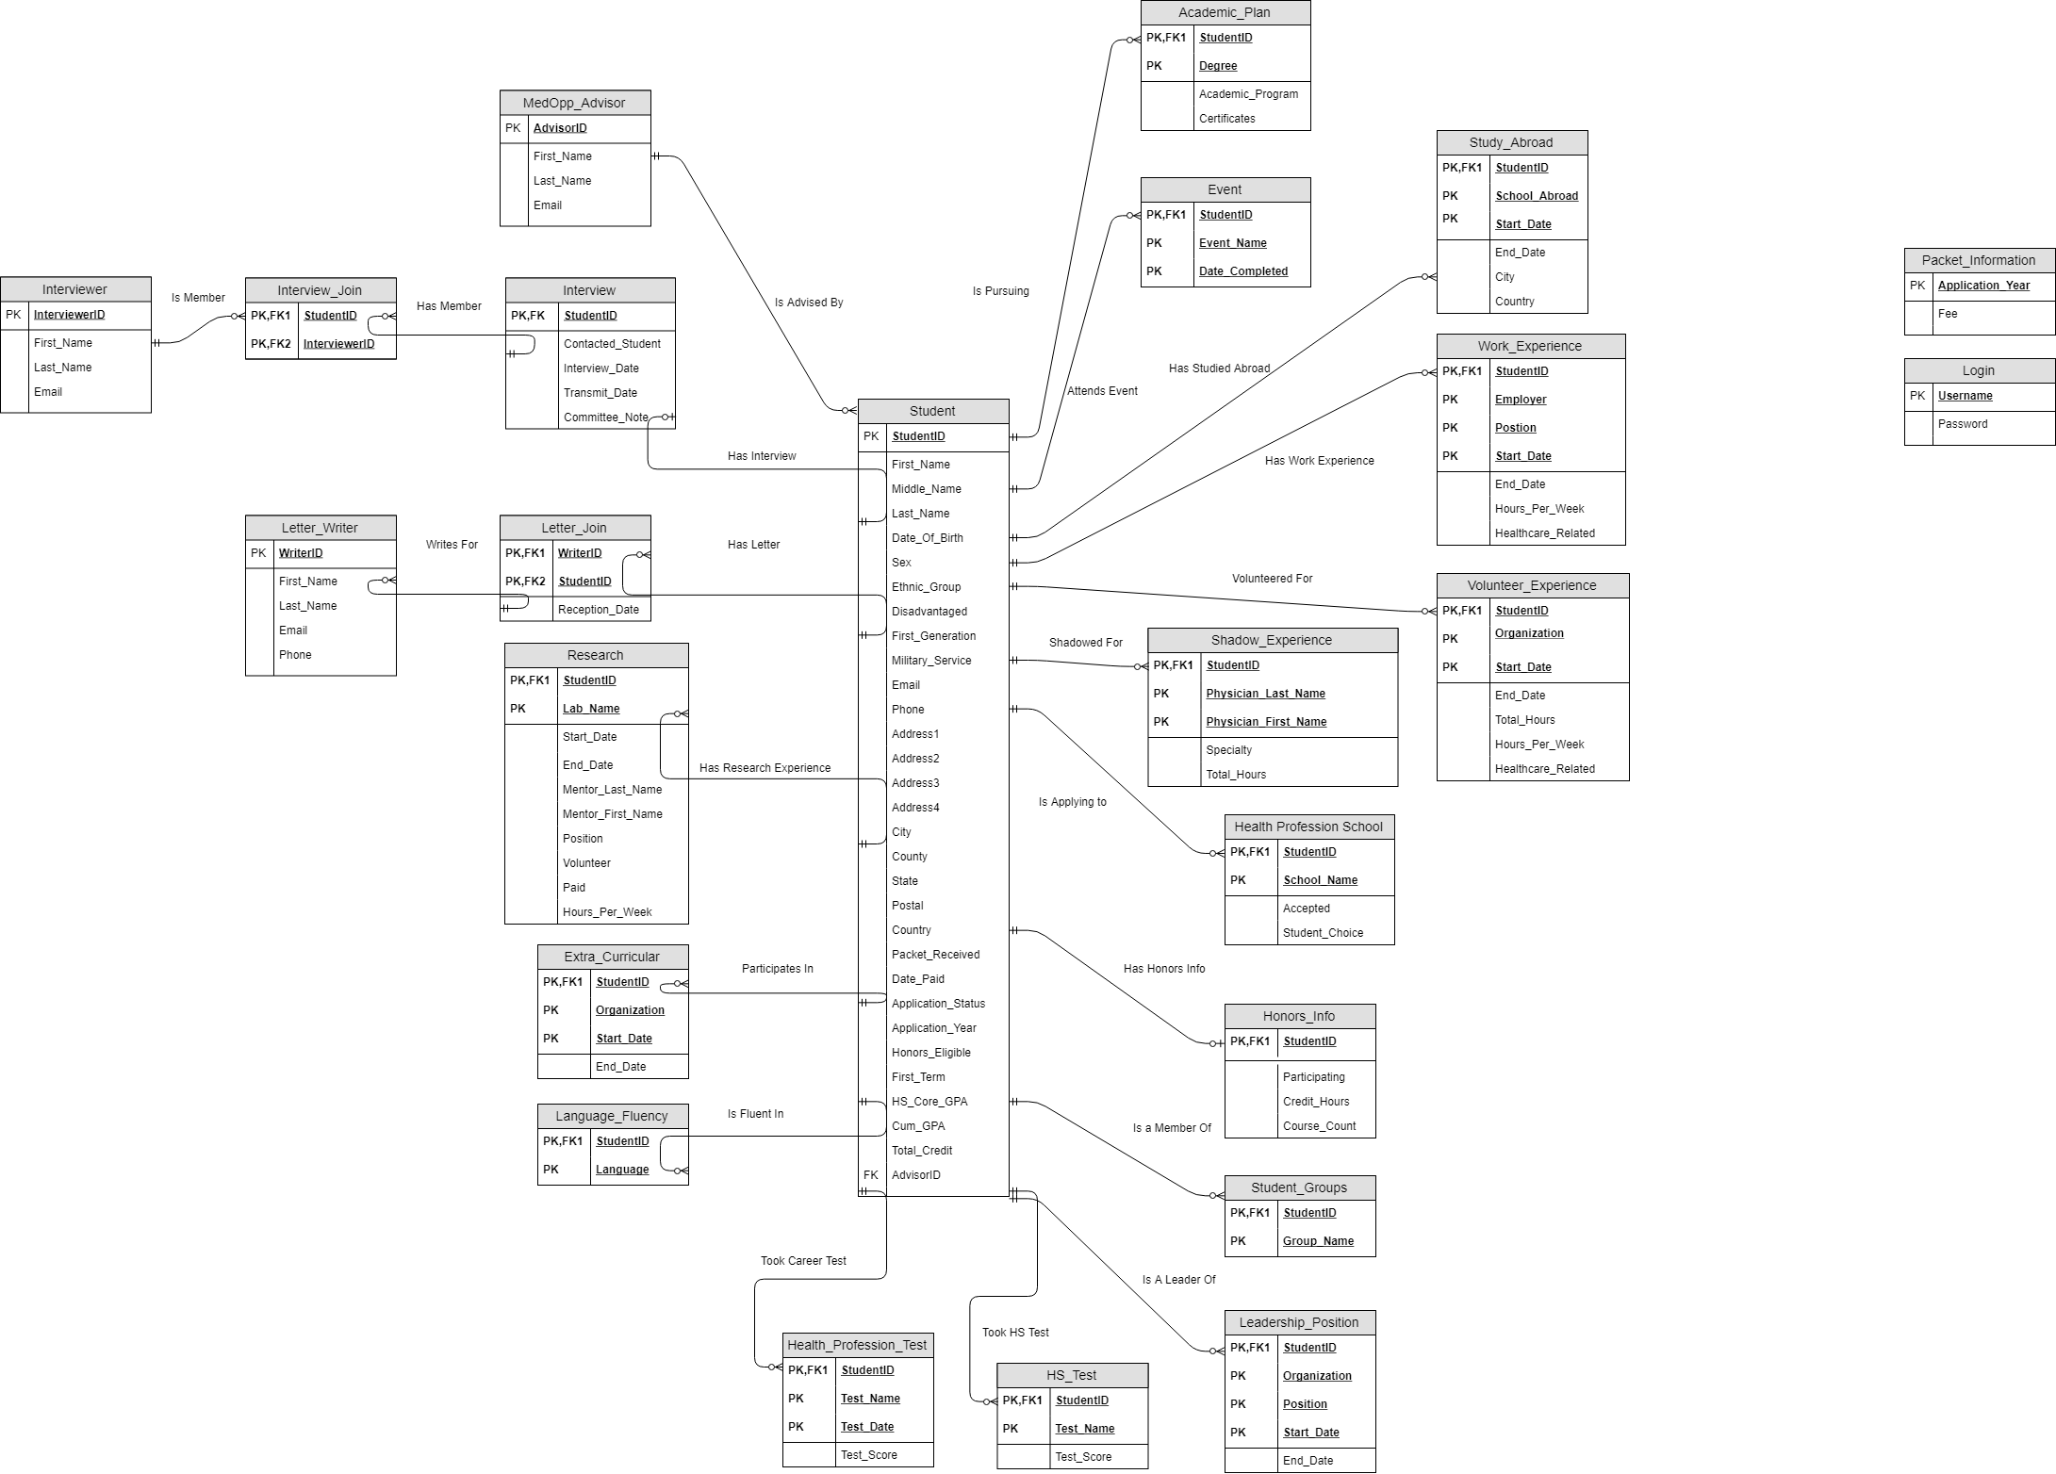
Final ERD
The database structure is built around student records, with every table, excepting their advisor, being an optional relationship.
While optional, a good medical professional candidate will be filling every one of them.

Slide 6
Backend
Site run by a simple, yet powerful PHP MVC architecture.
Pages are loaded by sending navigation instructions, or form data which is received by the controller and turned into navigation instructions. These instructions each call different methods in the model that pass page data back to the controller to be sent to the view to create the page’s content.
Bootstrap was heavily used to achieve a clean look without killing ourselves with CSS.
All data has leading white space trimmed before insertion, with empty values being set to null to avoid non varchar columns from breaking.

Slide 7
Security Considerations
First and foremost, we have a login for the MedOpp advisors. If the user is not logged in, they cannot access any part of our system.
Since they are the only users and need full access, no restrictions were placed on their user accounts.
To populate records and conduct searches, all relevant information is sent through POST data, which keeps sensitive information out of the URL.
Every query is run using prepared statements.

Slide 8
Live Demo
https://web.dsa.missouri.edu/~amv7vc/

Slide 9
Questions
And thank you for your time!

